Slide 1



Customer sale From Excel
View in Power BI
Last data refresh:
12/26/2025 3:40:37 AM UTC
Downloaded at:
12/26/2025 3:41:30 AM UTC

Slide 2
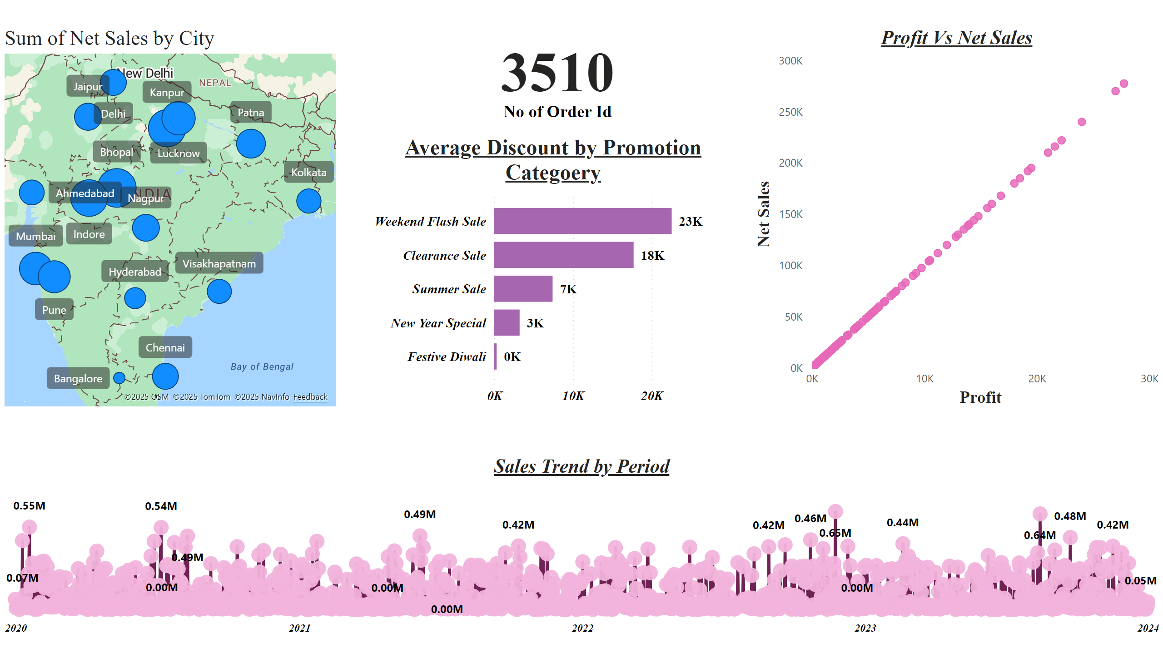
Overview
Notes:
Sales Trend by Period
No alt text provided
Profit Vs Net Sales
No alt text provided
Average Discount by Promotion Categoery
No alt text provided
azureMap
No alt text provided
card
No alt text provided

Slide 3
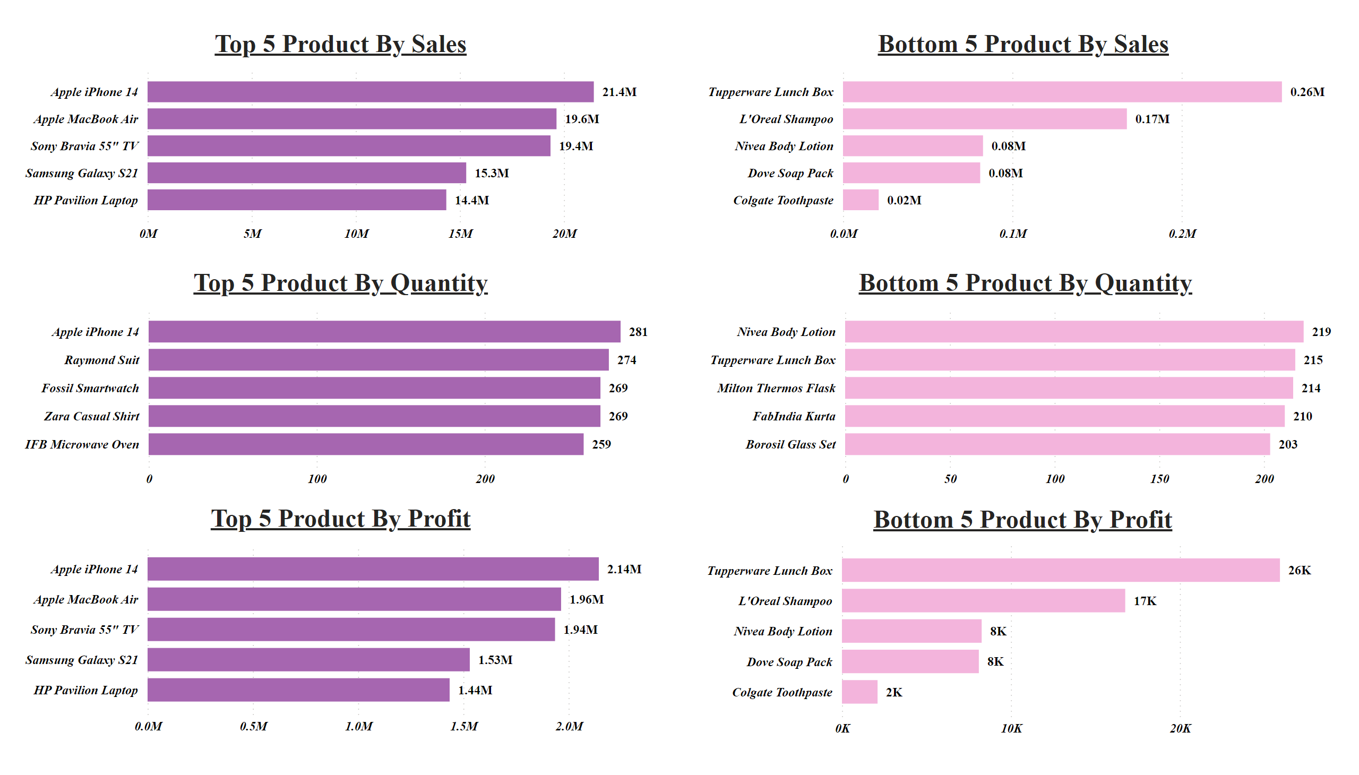
Top 5 / Bottom 5
Notes:
Top 5 Product By Sales
No alt text provided
Bottom 5 Product By Sales
No alt text provided
Top 5 Product By Quantity
No alt text provided
Bottom 5 Product By Quantity
No alt text provided
Top 5 Product By Profit
No alt text provided
Bottom 5 Product By Profit
No alt text provided

Slide 4
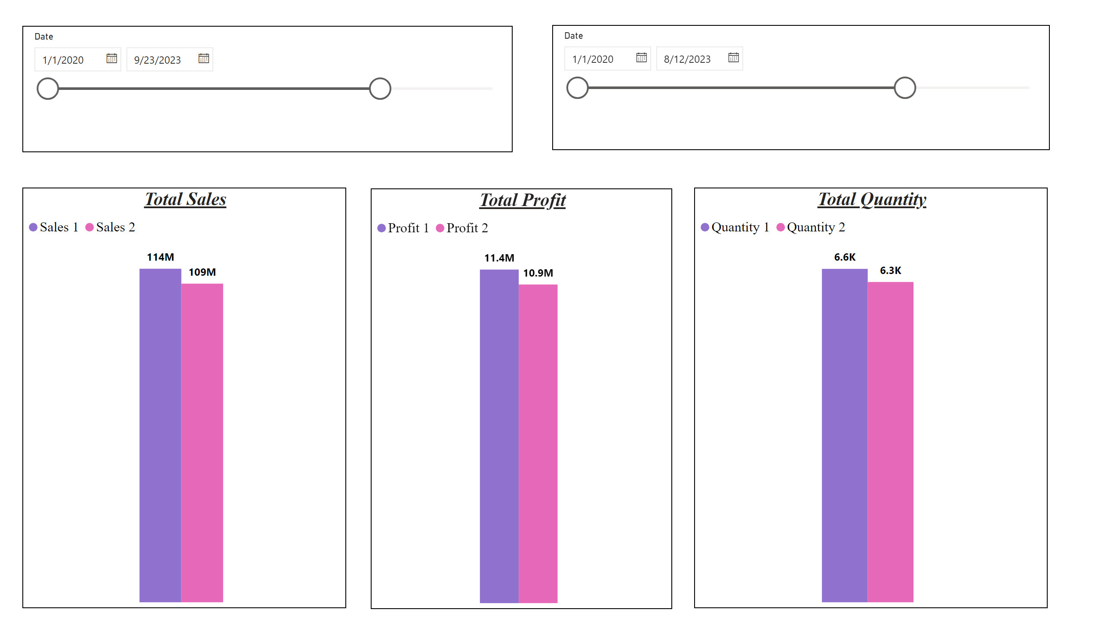
Comparision for Sale/Profit/Quantity
Notes:
slicer
No alt text provided
slicer
No alt text provided
Total Profit
No alt text provided
Total Sales
No alt text provided
Total Quantity
No alt text provided

Slide 5
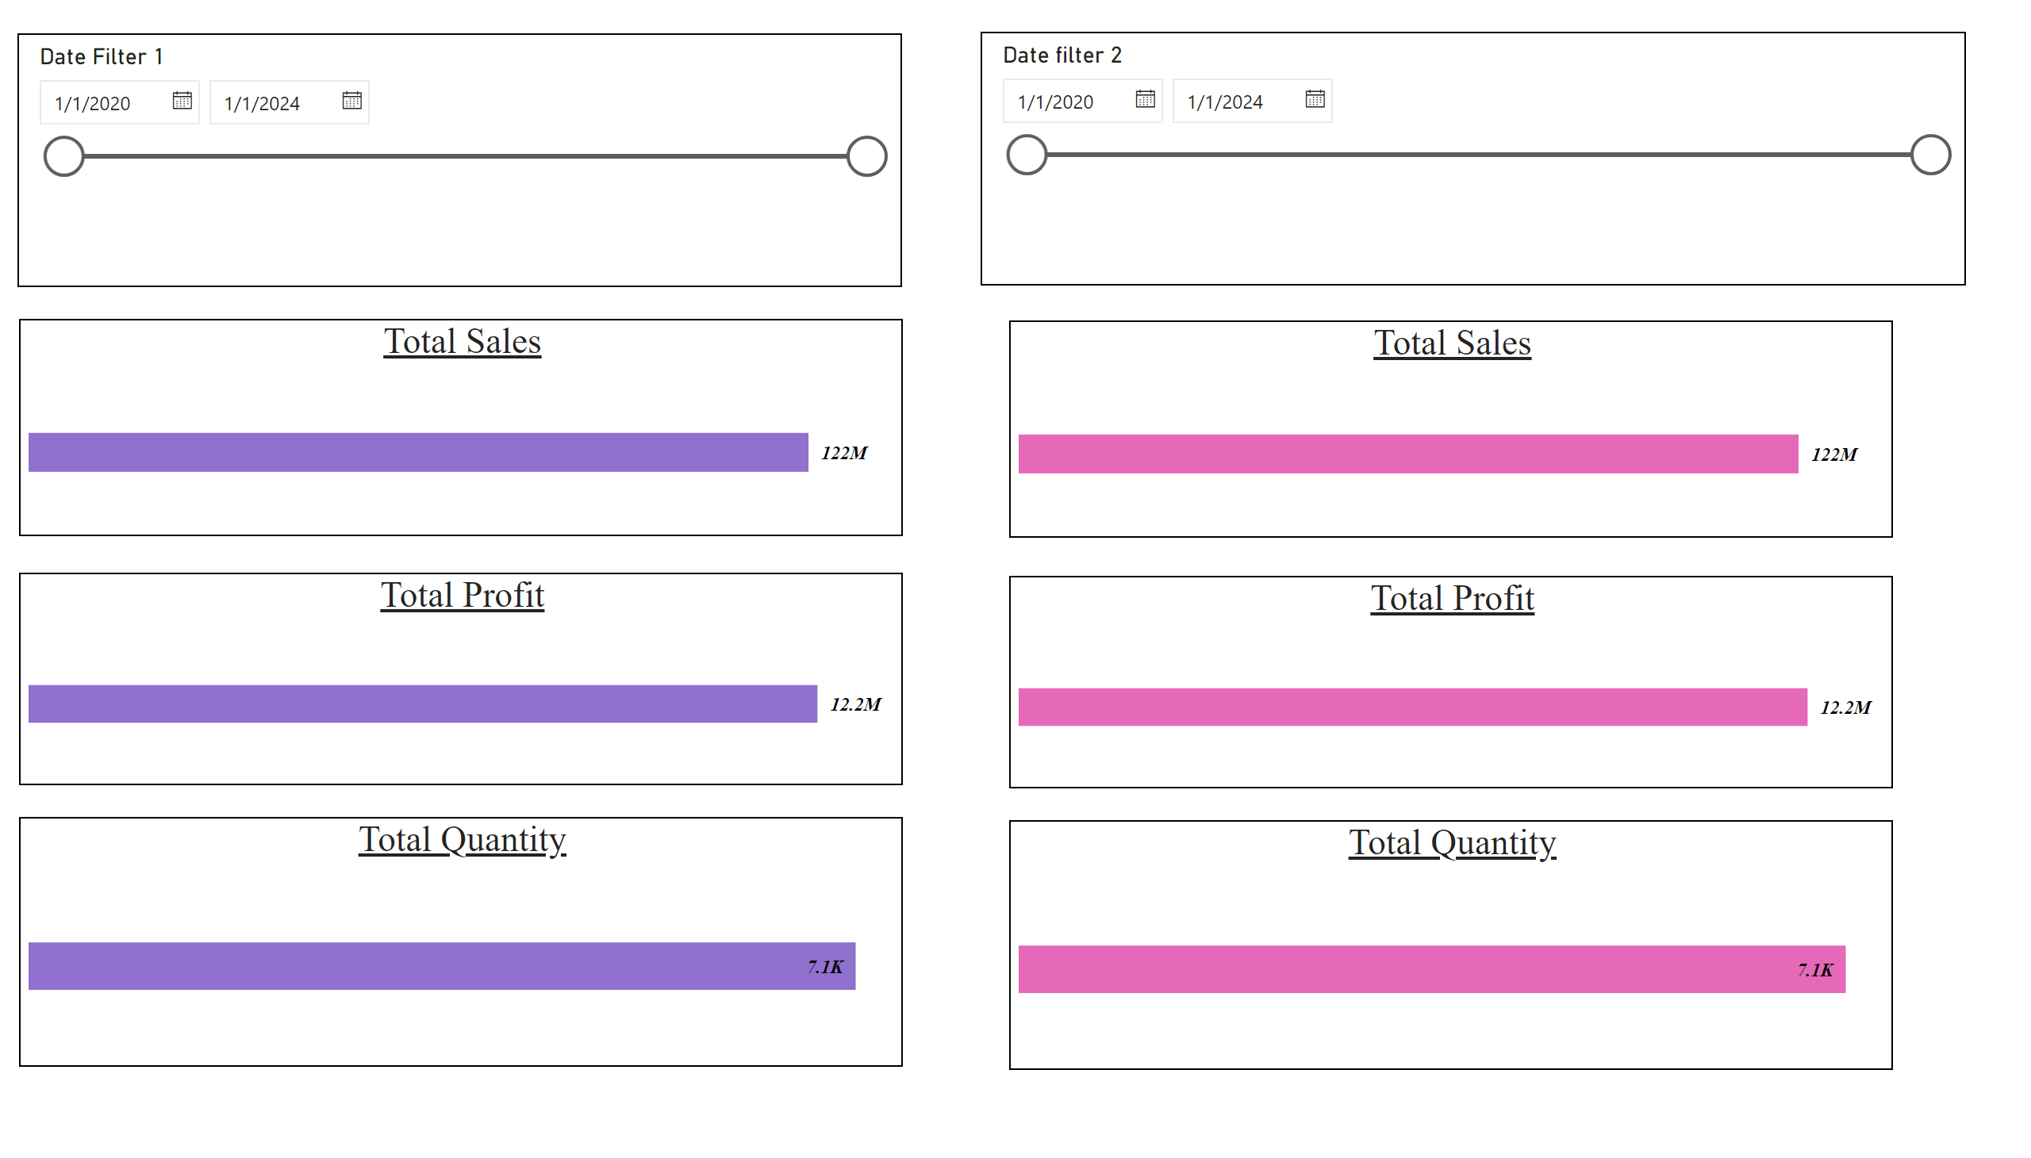
Edit Interaction
Notes:
slicer
No alt text provided
slicer
No alt text provided
Total Sales
No alt text provided
Total Profit
No alt text provided
Total Quantity
No alt text provided
Total Sales
No alt text provided
Total Quantity
No alt text provided
Total Profit
No alt text provided

Slide 6
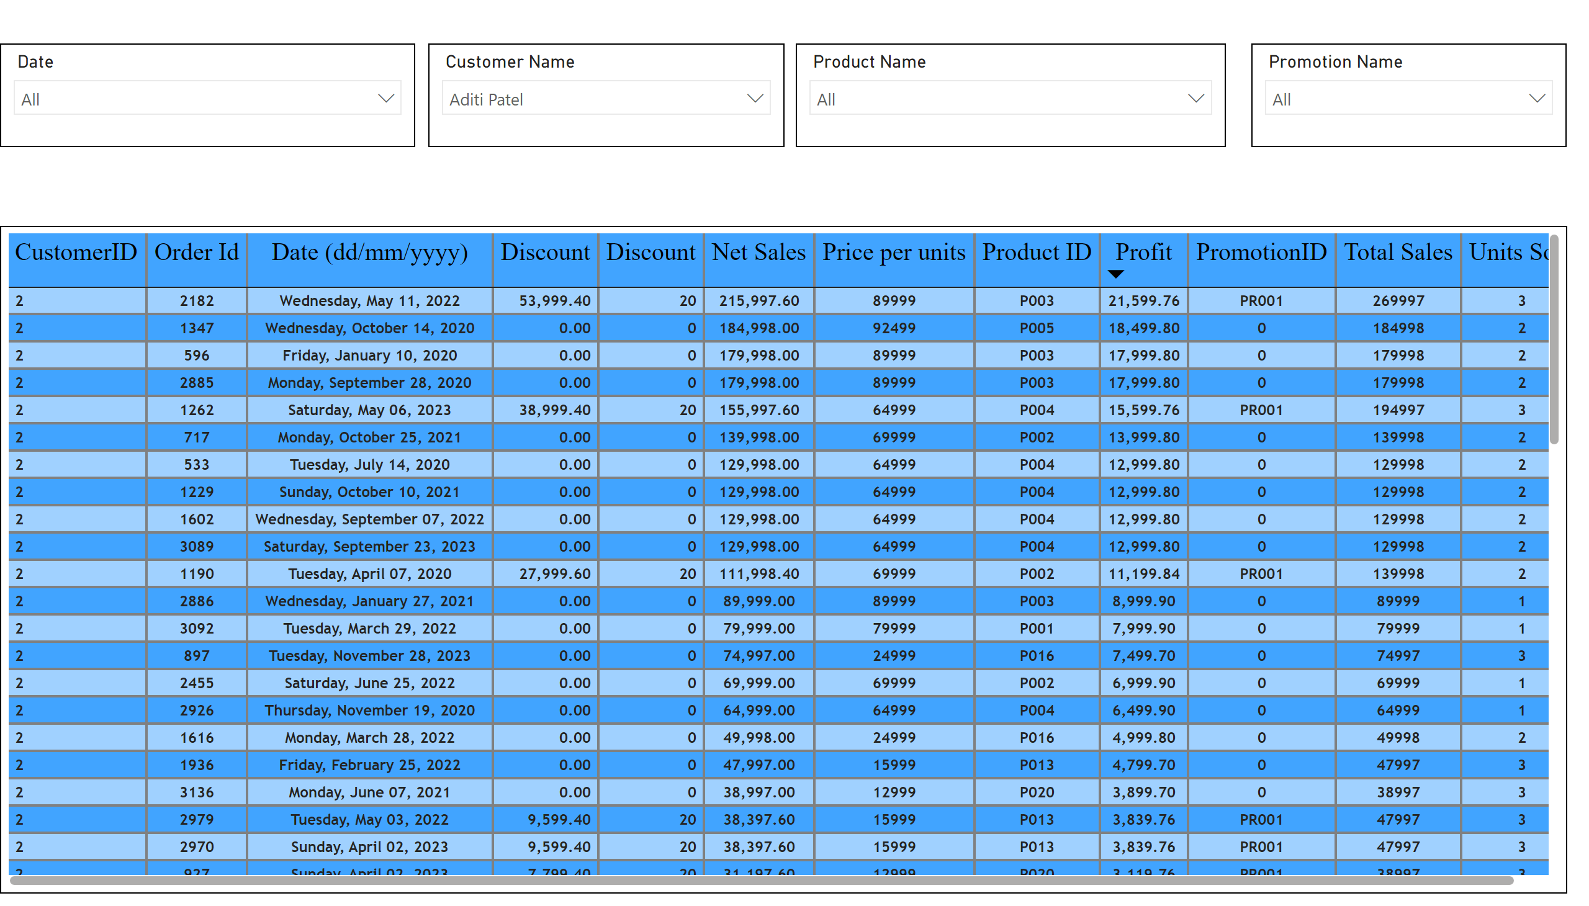
Table Visual
Notes:
tableEx
No alt text provided
slicer
No alt text provided
slicer
No alt text provided
slicer
No alt text provided
slicer
No alt text provided

